Slide 1
HOME SWEET HOME
A sustainable future
Year 3/4 Science

Slide 2
A tent house of nomadic people of Tunisia (Africa)

Slide 3
A portable house in Mongolia (Asia)

Slide 4
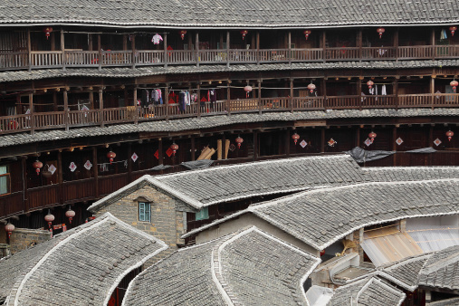
Mud and timber TOLU (China)
Many people live in these houses which are like units. They make bricks using mud and bamboo sticks.

Slide 5
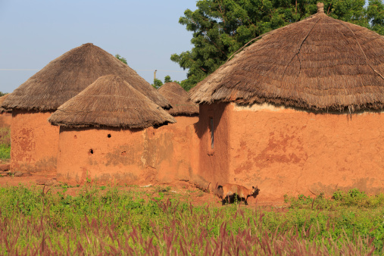
Mud, straw and wood houses.
Africa

Slide 6
Timber, grass and bamboo houses in Indonesia

Slide 8
Stone and rock houses in Turkey

Slide 9
Bush shelter in Australia

Slide 10
Brick, mud, stone and wood houses in Iran

Slide 11
The wind blows through here. Shortly after noon, the wind from the ocean in the south comes blowing through this are towards the desert in the north. This is because is in the Kutch region of India. Its roof is firmly tied down with rope so that it does not blow away in the wind.
The grass roof and the earthen walls block the heat outside. The women draw designs on the outside walls. The inside of the house is also elaborately decorated.

Slide 12
Igloos are made from bricks of ice, cut from the ground.

Slide 13
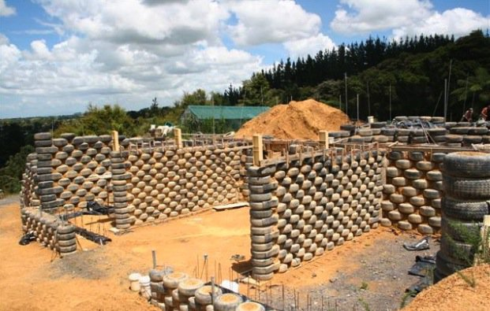
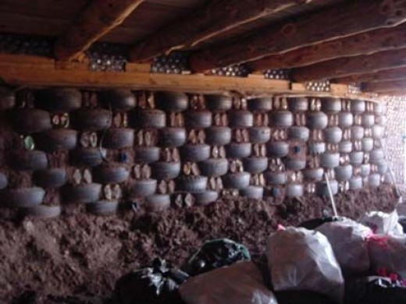
Earthships are made from recycled materials

