Slide 1
POETRY
Writing our own poems

Slide 2
Poems have a rhythm and rhyming schema
12
12
12
11
12
11
12
12
A
A
B
B
C
C
A
A

Slide 3
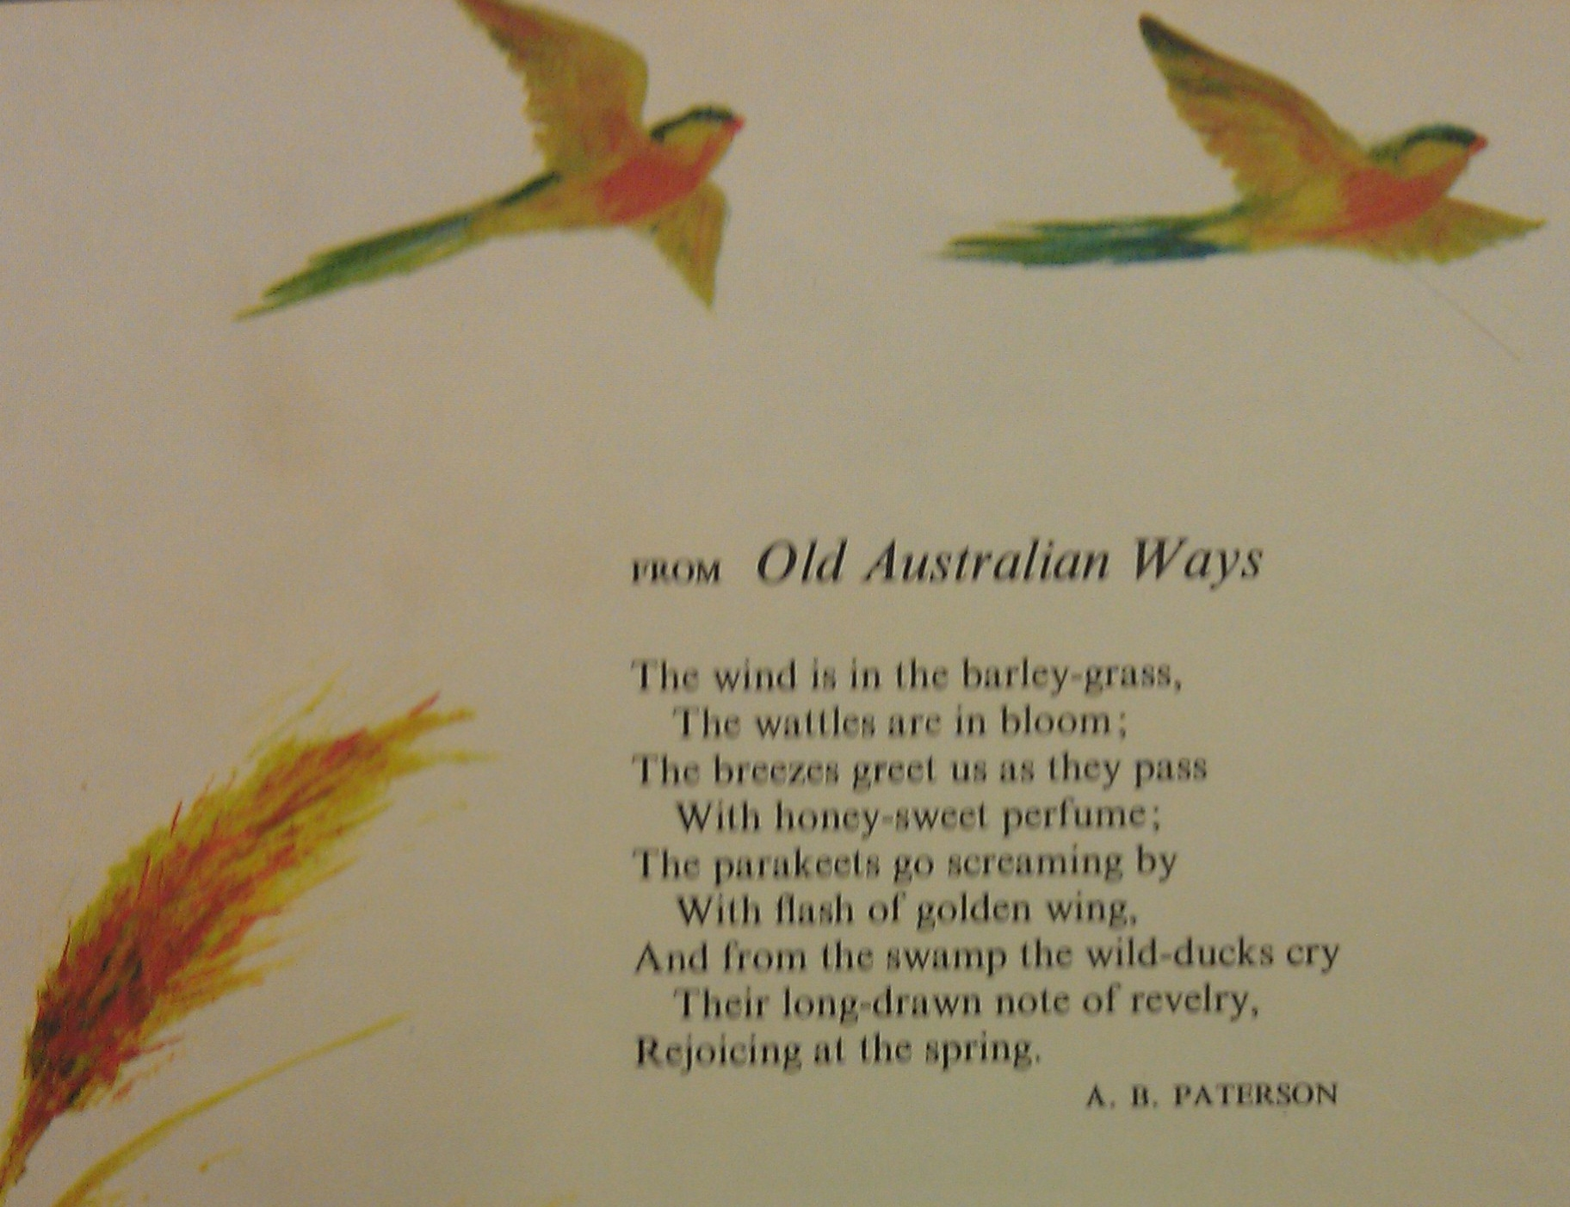
Old Australian Ways by A.B. Patterson
The wind is in the barley-grass,
The wattles are in bloom;
The breezes greet us as they pass
With honey-sweet perfume;
The parakeets go screaming by
With flash of golden wing,
And from the swamp the wild- ducks cry
Their long-drawn note of revelry,
Rejoicing at the spring.
A
B
A
B
C
D
C
E
D

Slide 4
Making a Y Chart
Sounds Like
What words describe what you hear
Looks Likes
Feels Like
What words describe what you want others to see
What words describe how something feels or
What words describe how someone feels

